Slide 1
FPGA Packet Filter With Custom Ethernet MAC and Webserver on RISC-V
Undergraduate thesis seminar
Matthew Gilpin 45801600
Supervisor: Dr Matthew D’Souza

Slide 2
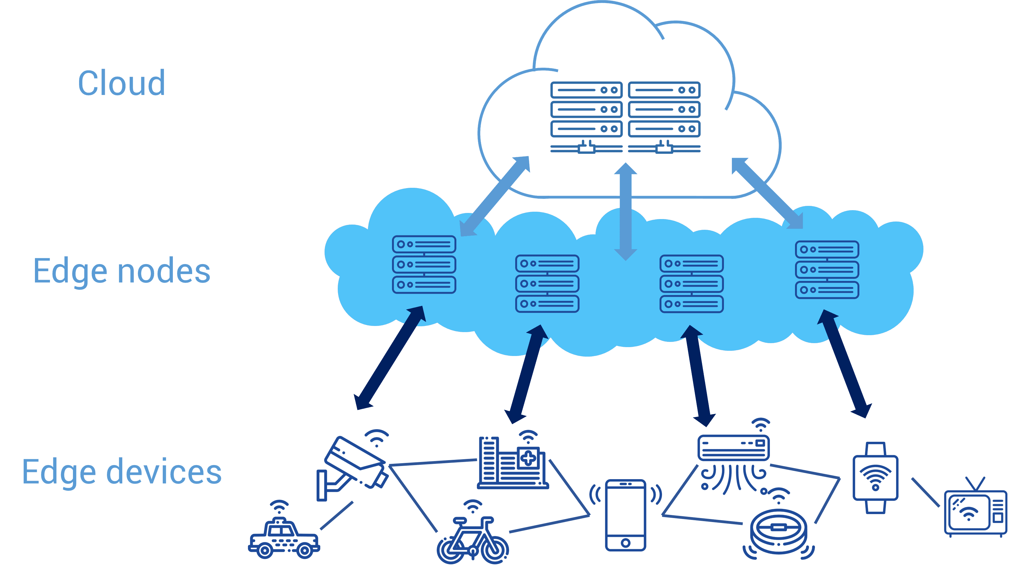
Edge networks and Security
Move computing to the edge – closer to the source of data.
Low power, highly distributed systems.
Lower network bandwidth.
Increasing security is needed.

Slide 3
Firewalls
Block certain networks from passing through based on several conditions
Isolate private networks from public networks to increase security [1]
Packet filter is one of the most simple design
Some firewalls can do things like deep packet inspection
Firewalls can be done in hardware or software [1]

Slide 4
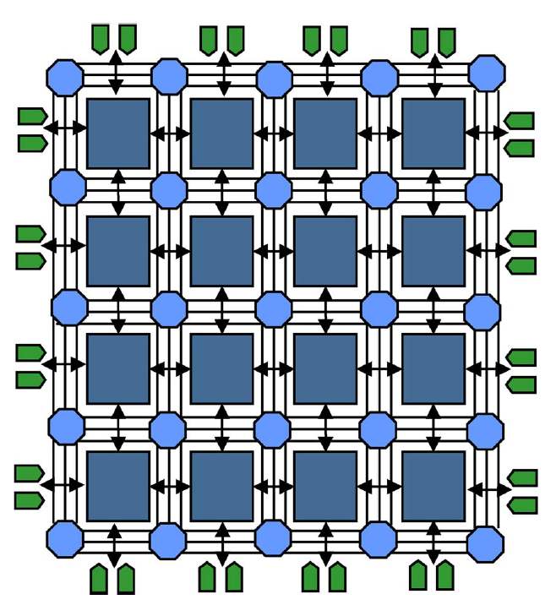
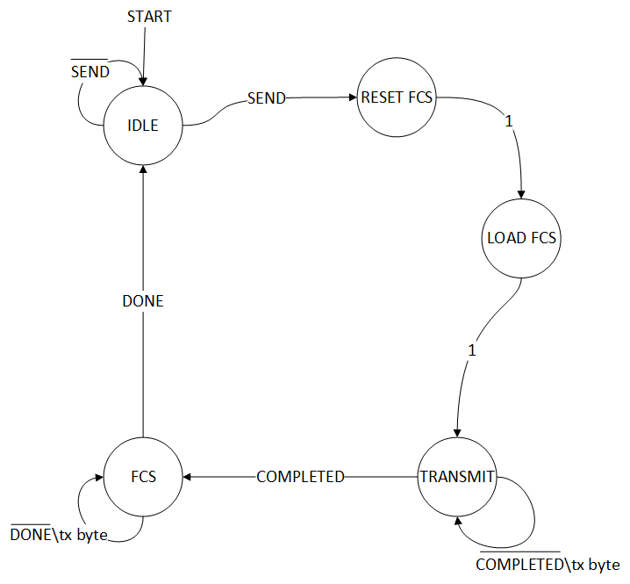
FPGAs
Field Programmable Gate Array
Custom logic - Define own architecture - Allows for parallelisation and optimisation - Power efficient
Use case in Ethernet MACs - Calculate FCS (CRC32) on the fly - Filter data at wirespeed - All while processor can be doing other things - Equates to low latency and high throughput.
System on Chips (SoC) – Integrate custom hardware with existing hardware/IP (eg, processor cores)
FPGA architecture
Ethernet Transmit FSM

Slide 5
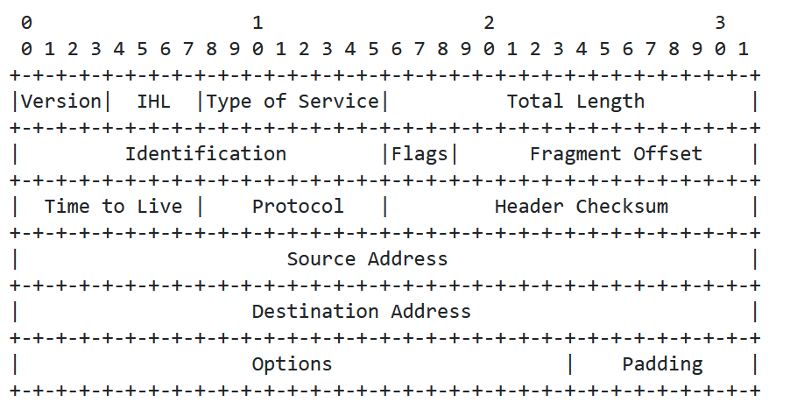
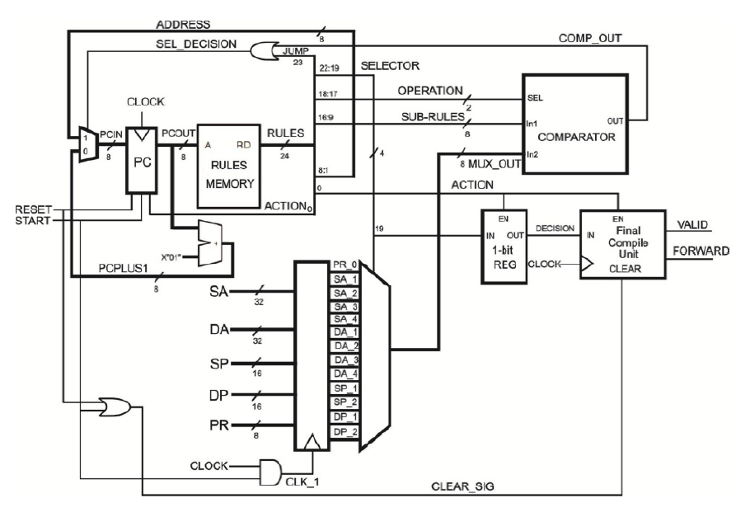
Packet filtering techniques
‘5 tuple’ fields to filter on - Source IP, Dest IP, Source Port, Dest Port, Protocol
Sequential matching - Trivial solution and easy to implement - Does not scale well - Might have 10+ of rules/patterns
Hierarchical tree-based algorithm [2] - Inspects multidimensional fields of IP header - Uses parallel decision trees.
IPv4 Header
Packet classifier [2]

Slide 6

RISC-V
Royalty-free Instruction Set Architecture (ISA)
Can be used to handle more complex but low priority tasks.
Used for running webserver
Easier to write software than hardware – faster development cycle

Slide 7
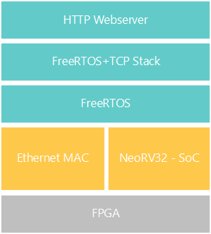
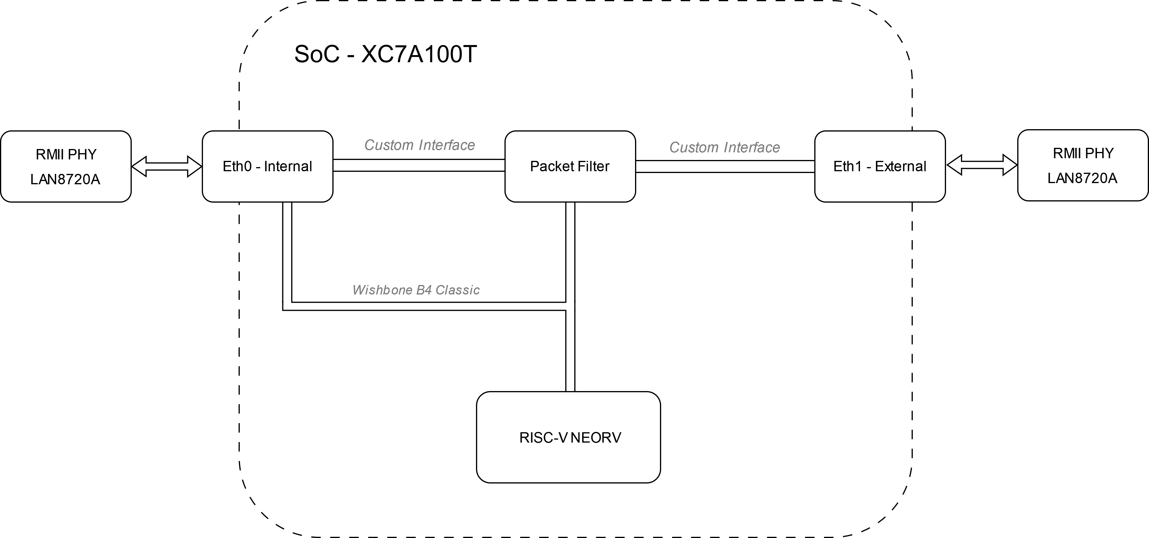
Implementation
Using Xilinx Artix 7 100T (XC7A100T-1CSG324) FGPA.
Neorv32 MCU – RISC-V softcore written in vendor agnostic VHDL
Custom Ethernet MAC connected over Wishbone bus. - Better control over packet filtering - Easier to write drivers
Wishbone B4 Classic – 32bit wide full duplex interconnect - Ties into the 32bit address space on the Neorv32
FreeRTOS with FreeRTOS-Plus TCP stack
Integration stack
Hardware layout

Slide 8
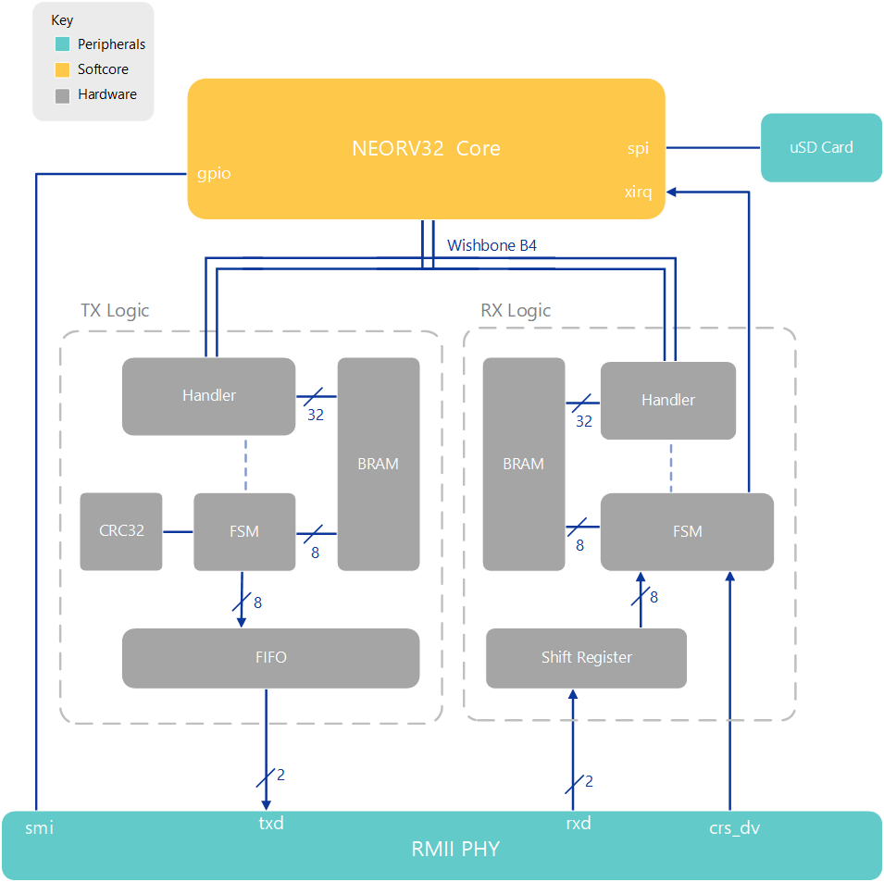
Current hardware architecture
Handler interfaces with memory and wishbone
FSM handles the data manipulation
FIFO and Shift Register used to cross clock domains
Packets get constructed and stored in BRAM
FCS (CRC32) calculated on the fly
MicroSD card to store web content – FAT filesystem
SoC Architecture

Slide 9
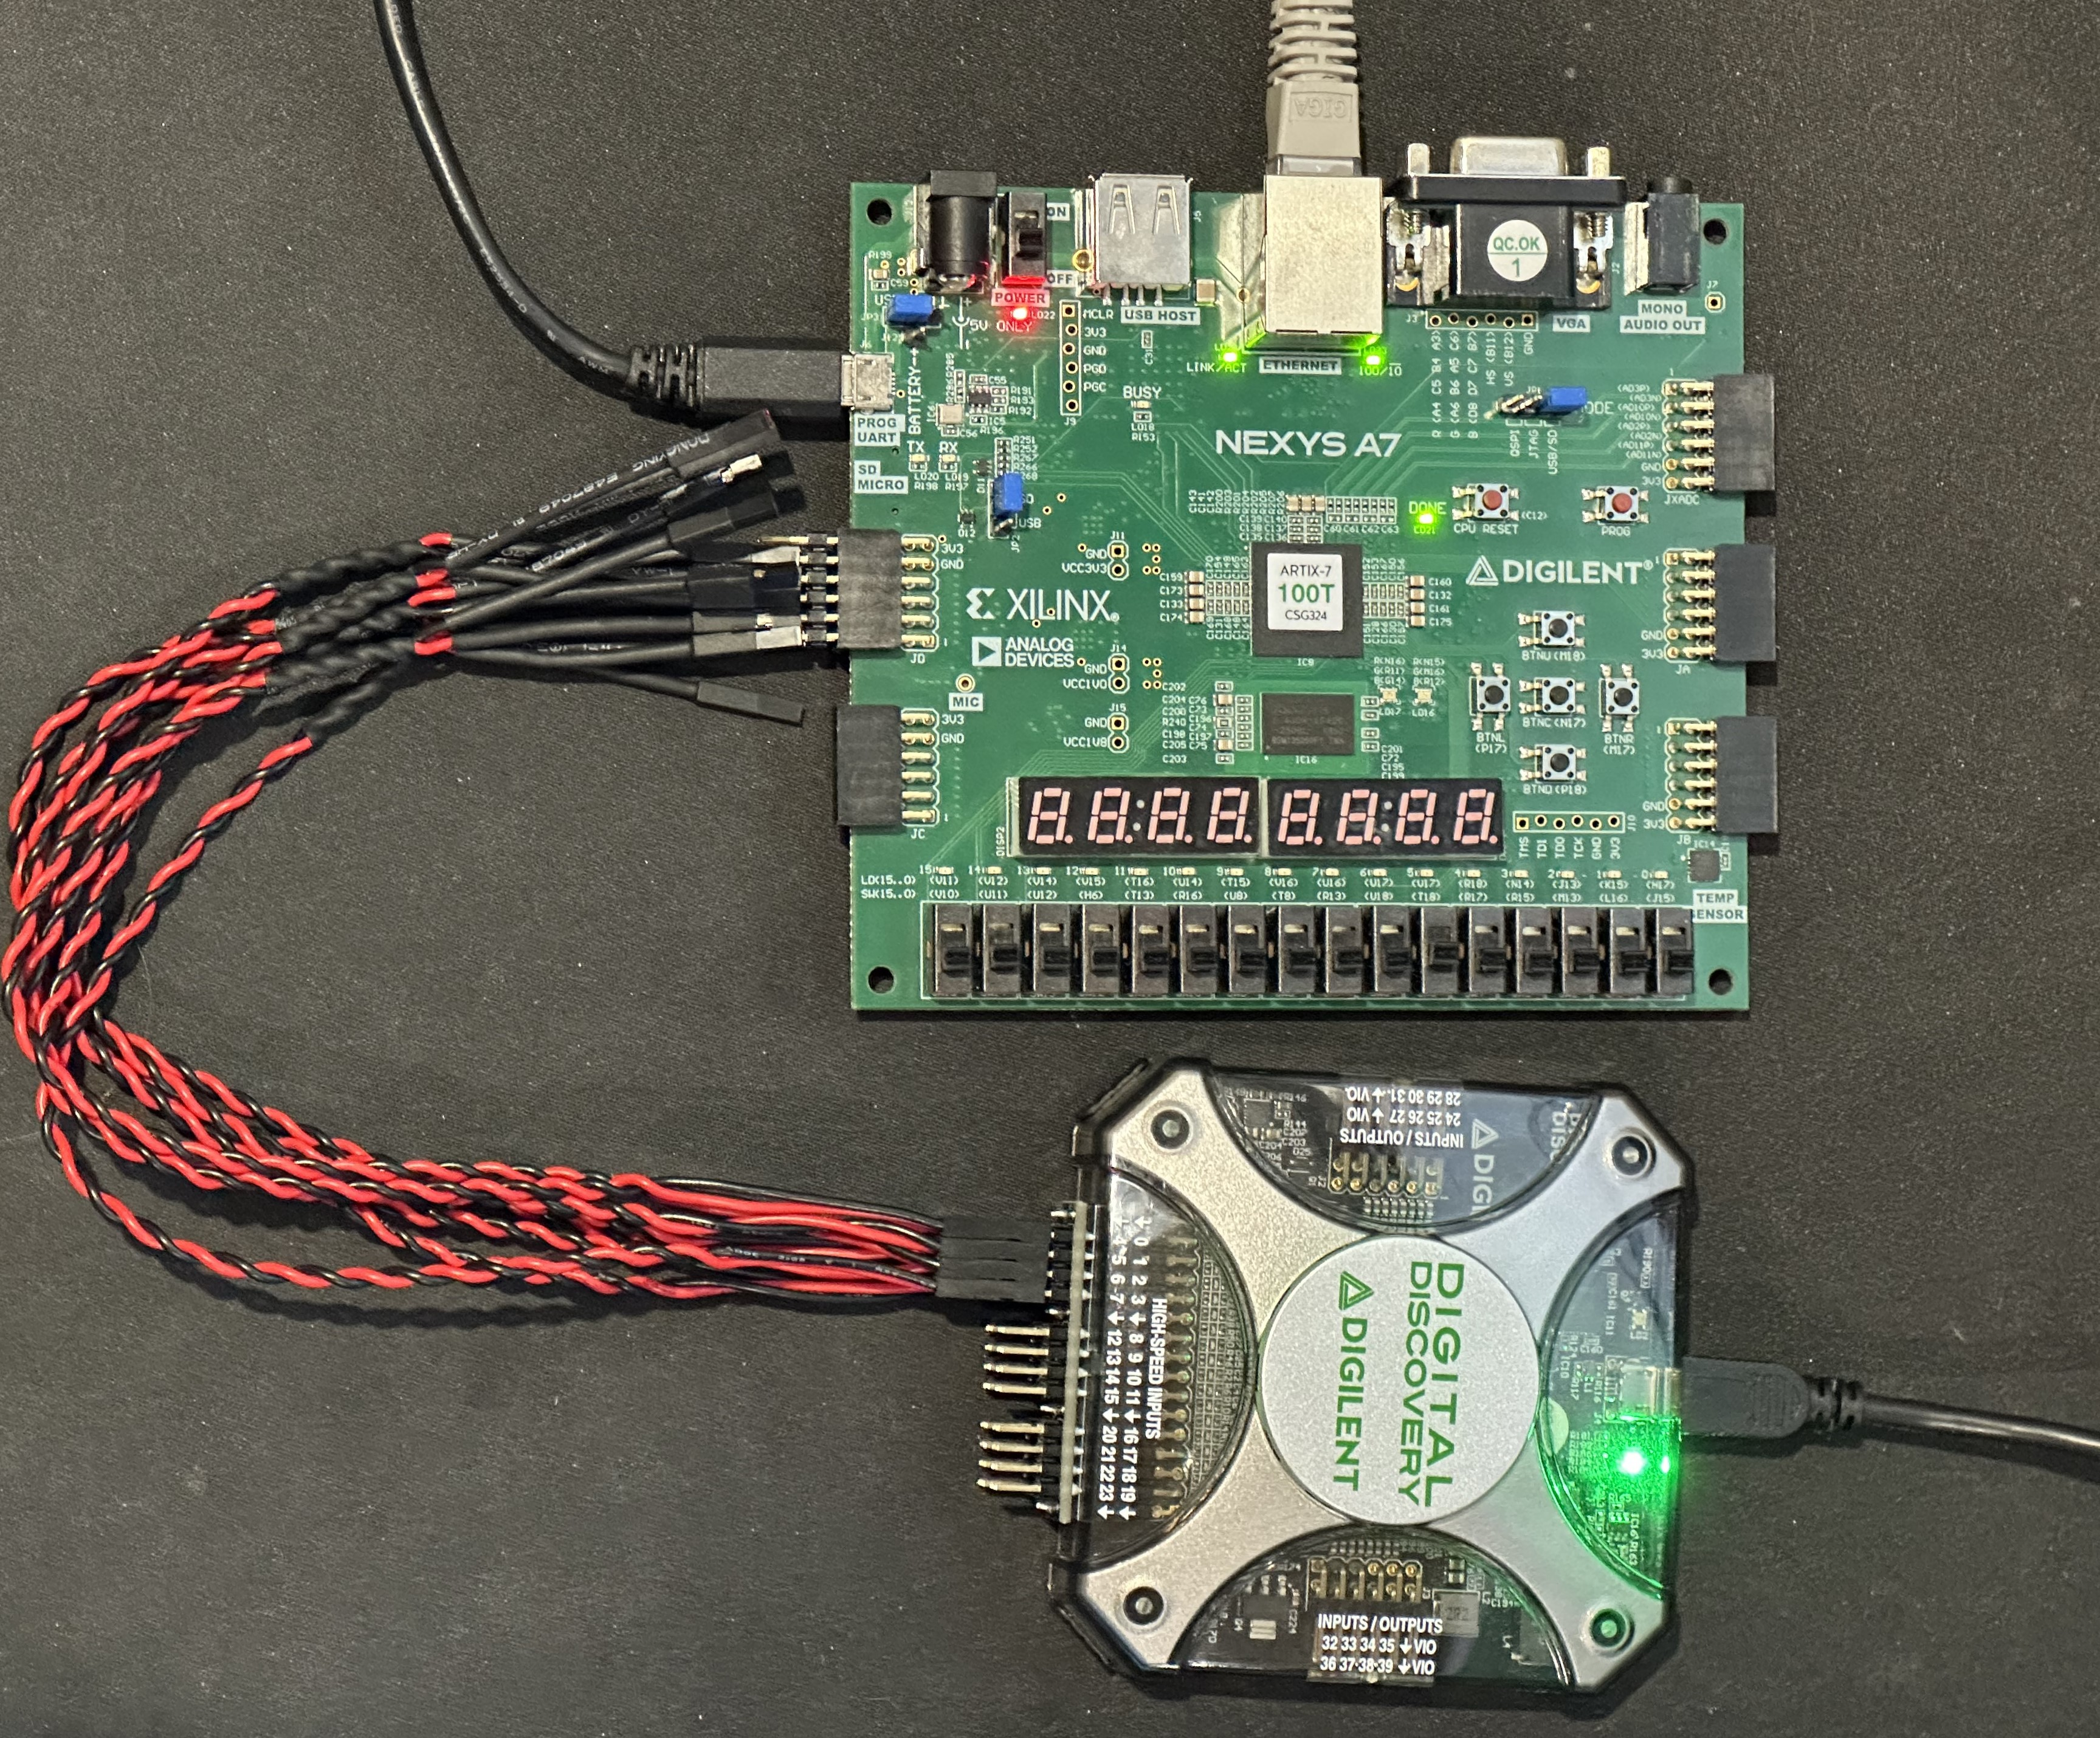
Testing
Developing for Diglient Nexys A7 - Xilinx Artix 7 100T (XC7A100T-1CSG324) FPGA - Onboard LAN8720A Ethernet PHY
Testing with a Digilent Digital Discovery Logic analyser - RMII operates 2 bit wide bus at 50Mhz. - Using high speed logic adaptor - 800MSa/s Sampling rate at 8 channels
Using simulations in Vivado to reduce time waiting for synthesis - Simulation of key hardware components in isolation - Hard to test specific microprocessor code in a simulation.
Testing Setup
Top: Nexys A7, bottom: Digital discovery

Slide 10
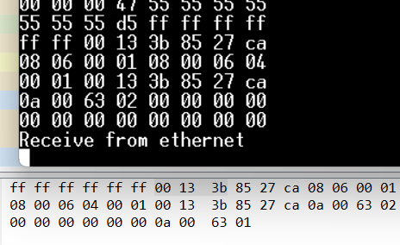
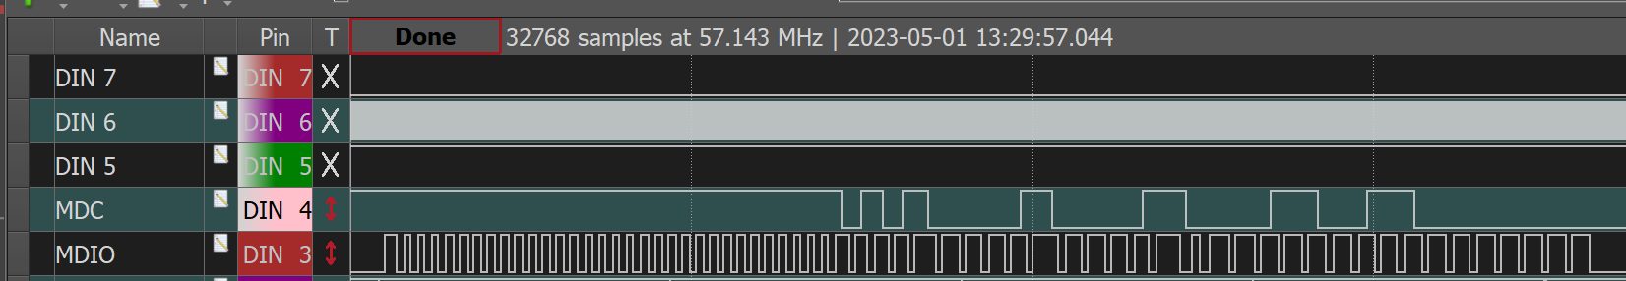
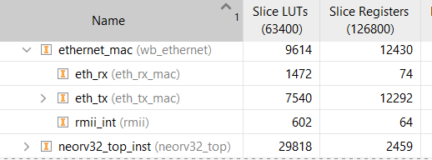
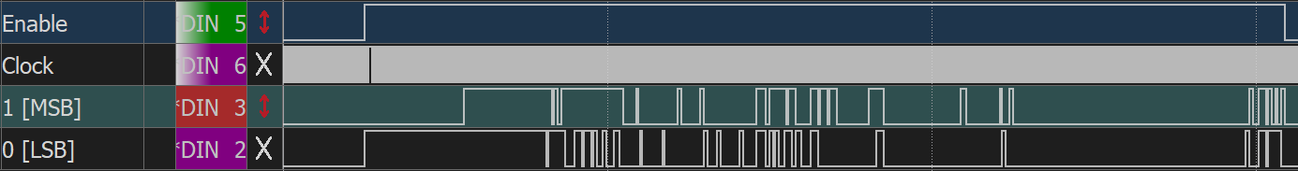
Progress
Serial Management Interface (SMI)
Ethernet Receive
Resource utilisation
62% LUT, 55% BRAM, 12% FF
Ethernet Transmit

Slide 11
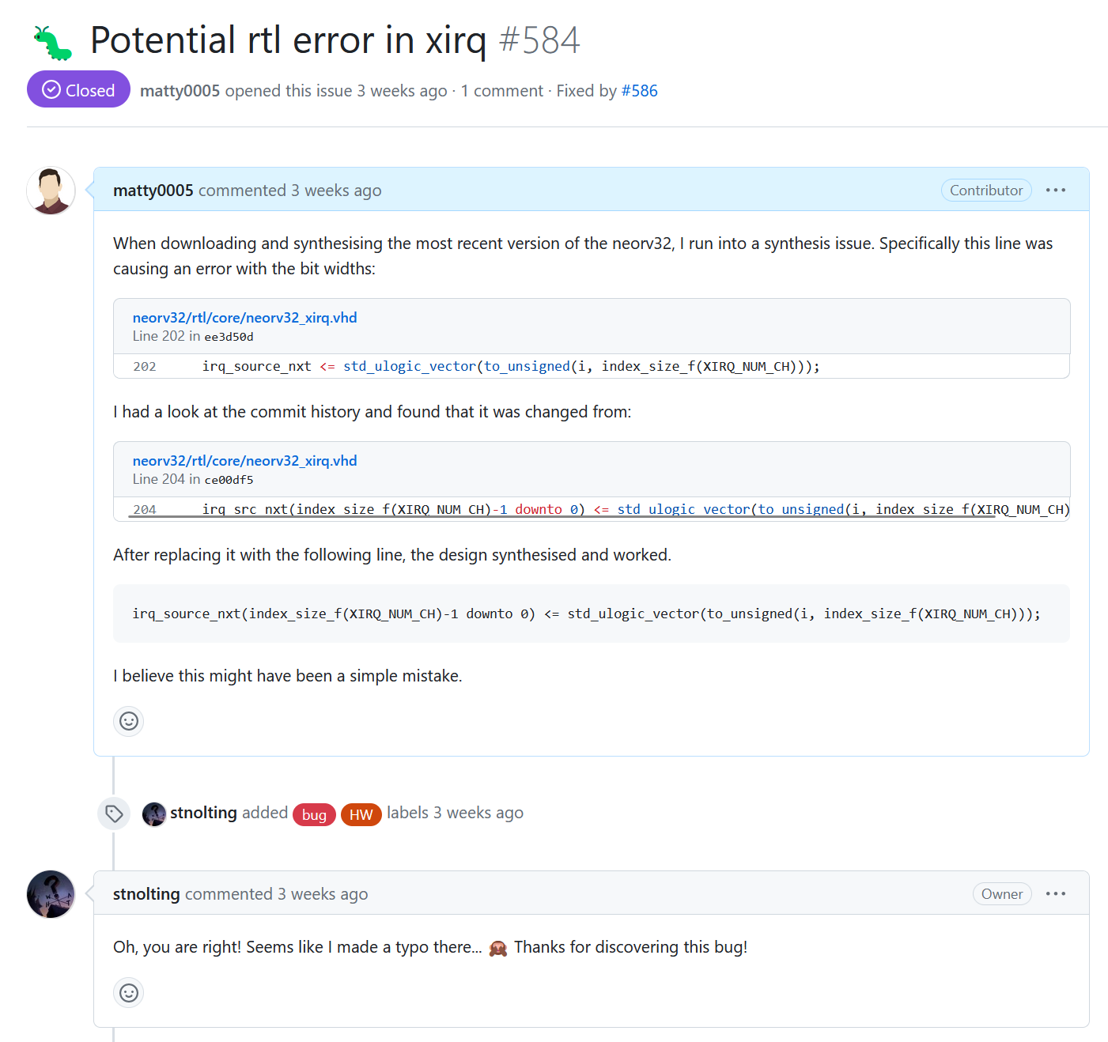

Contributions – neorv32
Detected hardware errors + added external interrupts with FreeRTOS example.
Pull requests for Neorv32 MCU.
Created example for external interrupts on Freertos
Xirq hardware bug find in Neorv32 MCU.

Slide 12
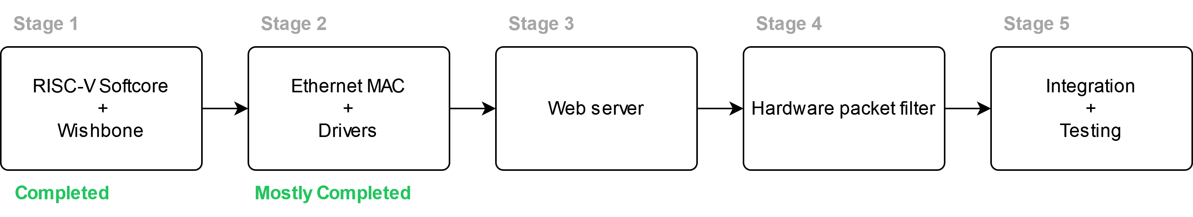
Project plan
Get Transmit logic working with RMII PHY
Finish Ethernet drivers for TCP stack
Get a filesystem working on a microSD card.
Create simple webserver
Create hardware filtering mechanism - tie that into the existing system.
Add second ethernet interface.

Slide 13
References
[1] E. D. Zwicky, S. Cooper, and D. B. Chapman, Building Internet Firewalls (2nd Ed.). USA: O’Reilly and Associates, Inc., 2000.
[2] A. Wicaksana and A. Sasongko, “Fast and reconfigurable packet classification engine in fpga based firewall,” in Proceedings of the 2011 International Conference on Electrical Engineering and Informatics, (Ithaca), pp. 1–6, IEEE, 2016.

Slide 14
Contact
Matthew Gilpin
m.gilpin@uq.edu.au

